Slide 1
H.E.L.L.O!

Slide 2
Warm-up!
Yawn and stretch
Lip trill like a horse through closed lips
Shoulders down – lip trill up
Knees bend – lip trill up then down
Super duper double bubble gum
Gu gu gu gu gum
Mummy made me mash my M and Ms
Zoo zoo zoo zoo zoo down

Slide 4
Recycling Rumba
Biosphere Big Sing

Slide 5
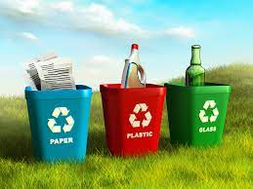
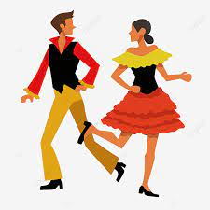
Full
Motivation! Innovation!
Motivation! Innovation!
Motivation! Innovation!
Yeah!
It’s the recycling Rumba (clap clap)
Don’t forget to put it in the bin
It’s the recycling Rumba (clap clap)
Every bit of plastic, yes
All your cardboard boxes, yes
All your empty tin-cans, yes
All your waste paper
Put them….in the bin

Slide 6
Reduce, (Motivation, Innovation) 2nd time only
Reuse, (Motivation, Innovation)
Our World, (Motivation, Innovation)
You choose (Motivation, Innovation)
We need a little more innovation
To close the plastic loop
We need a little more motivation
To close the plastic loop
Reduce, (Motivation, Innovation) 2nd time only
Reuse, (Motivation, Innovation)
Our World, (Motivation, Innovation)
You choose (Motivation, Innovation)

Slide 7
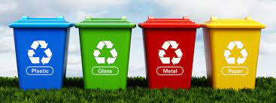
It’s the recycling Rumba (clap clap)
Don’t forget to put it in the bin
It’s the recycling Rumba (clap clap)
Every bit of plastic, yes
All your cardboard boxes, yes
All your empty tin-cans, yes
All your waste paper
Put them….in the bin

Slide 8
Rehearsal Slides

Slide 9
Motivation! Innovation!
Motivation! Innovation!
Motivation! Innovation!
Yeah!
It’s the recycling Rumba (clap clap)
Don’t forget to put it in the bin
It’s the recycling Rumba (clap clap)
Every bit of plastic, yes
All your cardboard boxes, yes
All your empty tin-cans, yes
All your waste paper
Put them….in the bin
This slide extract

Slide 10
Reduce, (Motivation, Innovation) 2nd time only
Reuse, (Motivation, Innovation)
Our World, (Motivation, Innovation)
You choose (Motivation, Innovation)
This slide extract
We need a little more innovation
To close the plastic loop
We need a little more motivation
To close the plastic loop
Reduce, (Motivation, Innovation) 2nd time only
Reuse, (Motivation, Innovation)
Our World, (Motivation, Innovation)
You choose (Motivation, Innovation)

Slide 11
Backing Track Slides

Slide 12
Backing
Motivation! Innovation!
Motivation! Innovation!
Motivation! Innovation!
Yeah!
It’s the recycling Rumba (clap clap)
Don’t forget to put it in the bin
It’s the recycling Rumba (clap clap)
Every bit of plastic, yes
All your cardboard boxes, yes
All your empty tin-cans, yes
All your waste paper
Put them….in the bin

Slide 13
Reduce, (Motivation, Innovation) 2nd time only
Reuse, (Motivation, Innovation)
Our World, (Motivation, Innovation)
You choose (Motivation, Innovation)
We need a little more innovation
To close the plastic loop
We need a little more motivation
To close the plastic loop
Reduce, (Motivation, Innovation) 2nd time only
Reuse, (Motivation, Innovation)
Our World, (Motivation, Innovation)
You choose (Motivation, Innovation)

Slide 14
It’s the recycling Rumba (clap clap)
Don’t forget to put it in the bin
It’s the recycling Rumba (clap clap)
Every bit of plastic, yes
All your cardboard boxes, yes
All your empty tin-cans, yes
All your waste paper
Put them….in the bin

