Slide 1
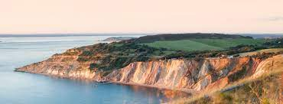
Protect Our Island
Biosphere Big Sing KS1/2

Slide 2
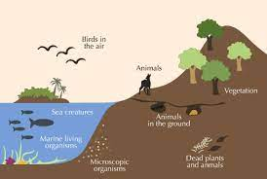
We’re gonna protect our Island
Protect our Biosphere
Protect our Island
By changing how we live

Slide 3
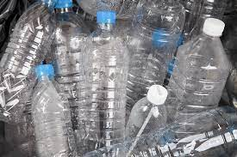
Reduce your use of single use plastics – try reusable
Only buy what you need when you need it – find some bargains second hand
Recycle everything you can – buy local food and drink
We’re gonna protect our Island
Protect our Biosphere
Protect our Island
By changing how we live

Slide 4
Plant a tree – to help reduce the carbon in the air
Turn lights off when you leave the room – to use less electricity
Use sustainable transport; take the bus, train, cycle or walk
We’re gonna protect our Island
Protect our Biosphere
Protect our Island
By changing how we live

Slide 5
Collect your rain - to save clean water which uses energy
Explore your local biosphere and find nature everywhere
Discover this beautiful Island, persuade your neighbours to do the same
We’re gonna protect our Island. (Doing what we can)
Protect our Biosphere (To nurture what we have) Protect our Island. (Our forever plan)
By changing how we live
La la la la la la La la la la la la
La la la la la La la la la la
La la la la la la la La la la la la la la – oh oh.

Slide 6
Rehearsal slides

Slide 7
We’re gonna protect our Island
Protect our Biosphere
Protect our Island
By changing how we live

Slide 8
Reduce your use of single use plastics – try reusable
Only buy what you need when you need it – find some bargains second hand
Recycle everything you can – buy local food and drink

Slide 9
We’re gonna protect our Island. (Doing what we can)
Protect our Biosphere (To nurture what we have) Protect our Island. (Our forever plan)
By changing how we live
La la la la la la La la la la la la
La la la la la La la la la la
La la la la la la la La la la la la la la – oh oh.

Slide 10
Backing Track slides

Slide 11
Backing
We’re gonna protect our Island
Protect our Biosphere
Protect our Island
By changing how we live

Slide 12
Reduce your use of single use plastics – try reusable
Only buy when you need it – find some bargains second hand
Recycle everything you can – buy local food and drink
We’re gonna protect our Island
Protect our Biosphere
Protect our Island
By changing how we live

Slide 13
Plant a tree – to help reduce the carbon in the air
Turn lights off when you leave the room – to use less electricity
Use sustainable transport; take the bus, train, cycle or walk
We’re gonna protect our Island
Protect our Biosphere
Protect our Island
By changing how we live

Slide 14
Collect your rain - to save clean water which uses energy
Explore your local biosphere and find nature everywhere
Discover this beautiful Island, persuade your neighbours to do the same
We’re gonna protect our Island. (Doing what we can)
Protect our Biosphere (To nurture what we have)
Protect our Island. (Our forever plan)
By changing how we live
La la la la la la La la la la la la
La la la la la La la la la la
La la la la la la la La la la la la la la – oh oh.

