Slide 1
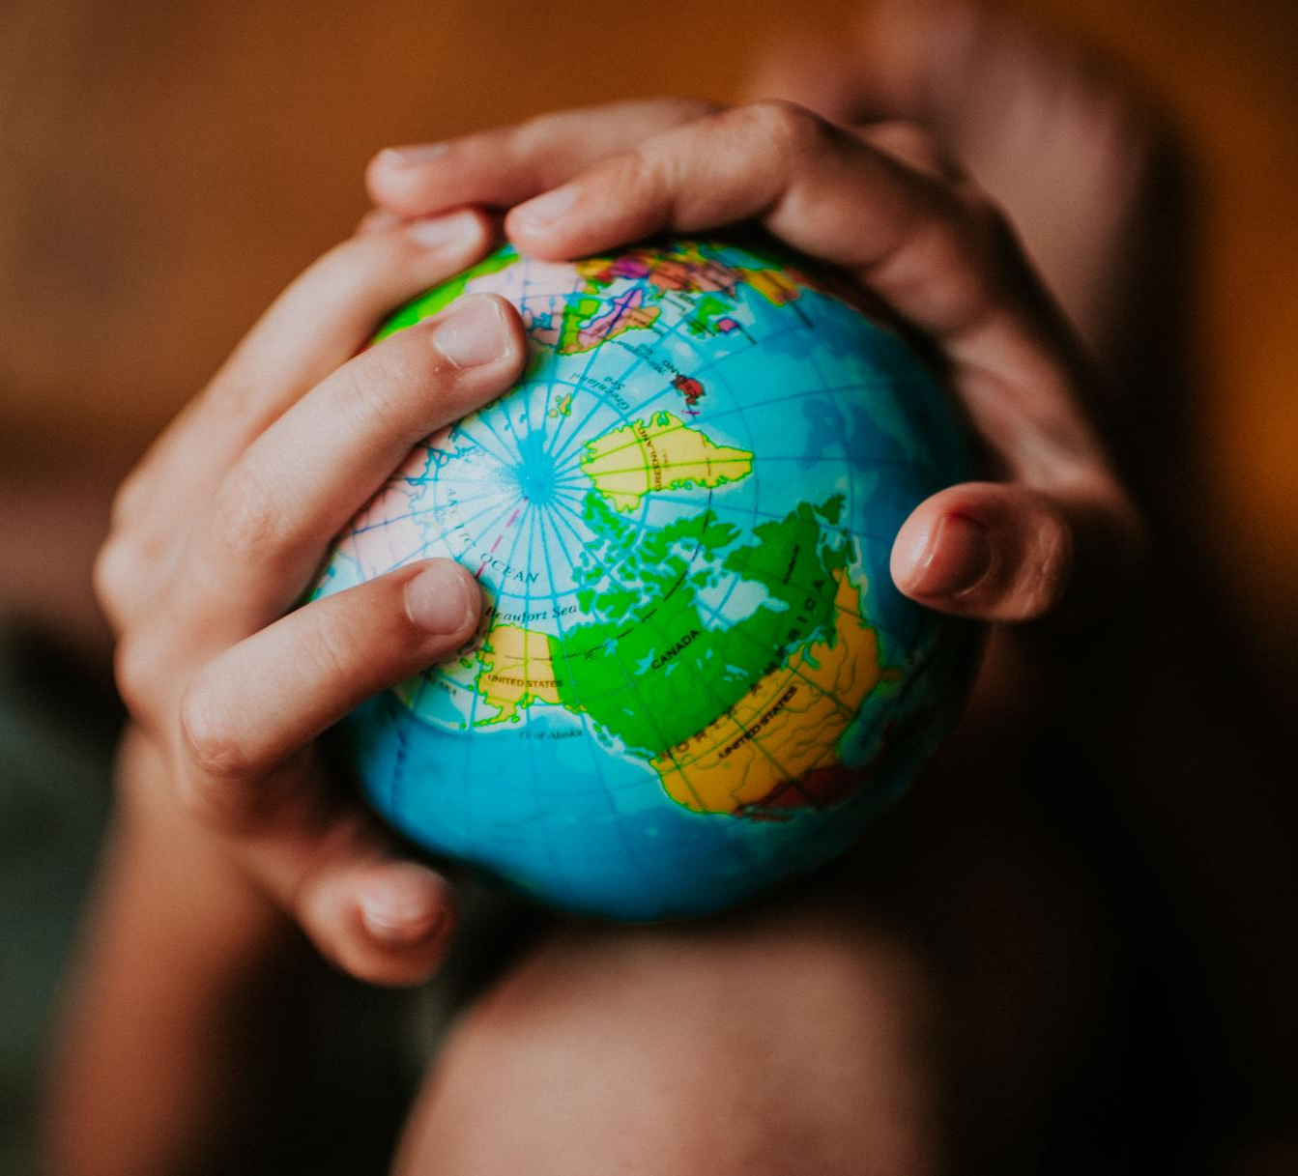
One World
Biosphere big sing
KS1/2

Slide 2
Stop and look around you, open up your eyes
And soon you will find, Earth’s great natural beauty
Is being compromised by acts of mankind
Pollution is rife, endangering life
The land, the sea, the air, pollution everywhere
We have One World, treat it with respect
Only One World, it’s our duty to protect
For the sake of future generations
Make a change right now.
Unite together for One World.

Slide 3
On our wonderous planet, actions people take
Cause complications. Think about your lifestyle,
Choices that you make, have implications
Be mindful of how, the things we do now
Will shape the planet’s fate, it’s time to educate
We have One World, treat it with respect
Only One World, it’s our duty to protect
For the sake of future generations
Make a change right now.
Unite together for One World.

Slide 4
Each and every one of us can make a difference,
Every single person plays a part
We can choose to spread the word
And lead by example, so let’s step up and make a start
We have One World, treat it with respect
(one world, one world)
Only One World, it’s our duty to protect
(one world, one world)
For the sake of future generations
(make a change right now)
Make a change right now.
Unite together for…(repeat chorus)
One World – unite together for One World

Slide 5
Rehearsal slides

Slide 6
Stop and look around you, open up your eyes
And soon you will find, Earth’s great natural beauty
Is being compromised by acts of mankind
Pollution is rife, endangering life
The land, the sea, the air, pollution everywhere

Slide 7
We have One World, treat it with respect
Only One World, it’s our duty to protect
For the sake of future generations
Make a change right now.
Unite together for One World.

Slide 8
Each and every one of us can make a difference,
Every single person plays a part
We can choose to spread the word
And lead by example, so let’s step up and make a start

Slide 9
We have One World, treat it with respect
(one world, one world)
Only One World, it’s our duty to protect
(one world, one world)
For the sake of future generations
(make a change right now)
Make a change right now.
Unite together for…(repeat chorus)
One World – unite together for One World

Slide 10
Backing track slides

Slide 11
Stop and look around you, open up your eyes
And soon you will find, Earth’s great natural beauty
Is being compromised by acts of mankind
Pollution is rife, endangering life
The land, the sea, the air, pollution everywhere
We have One World, treat it with respect
Only One World, it’s our duty to protect
For the sake of future generations
Make a change right now.
Unite together for One World.

Slide 12
On our wonderous planet, actions people take
Cause complications. Think about your lifestyle,
Choices that you make, have implications
Be mindful of how, the things we do now
Will shape the planet’s fate, it’s time to educate
We have One World, treat it with respect
Only One World, it’s our duty to protect
For the sake of future generations
Make a change right now.
Unite together for One World.

Slide 13
Each and every one of us can make a difference,
Every single person plays a part
We can choose to spread the word
And lead by example, so let’s step up and make a start
We have One World, treat it with respect
(one world, one world)
Only One World, it’s our duty to protect
(one world, one world)
For the sake of future generations
(make a change right now)
Make a change right now.
Unite together for…(repeat chorus)
One World – unite together for One World

