Slide 1
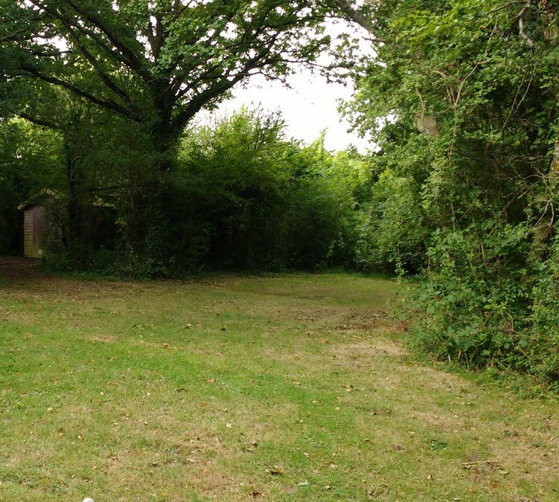
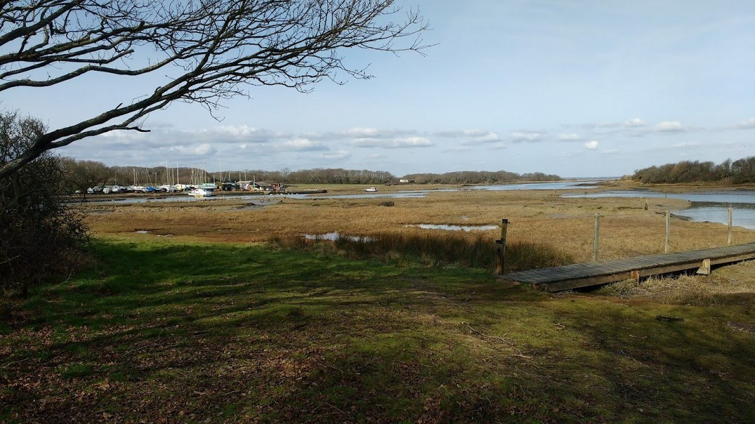
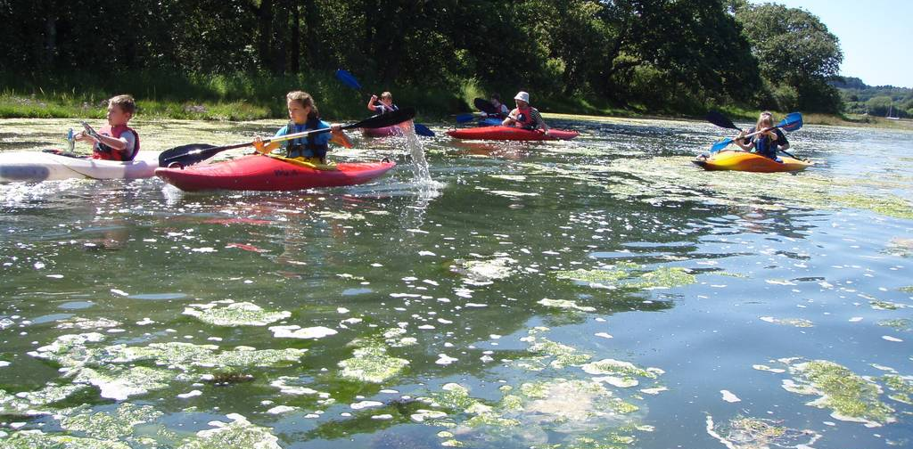
CORF FUN RUN
2.5k or 5k
SATURDAY 5TH MAY 2pm
Entry forms :corffunrun@gmail.com
Pre-entry closes Tuesday 1st May

