Slide 1

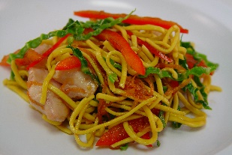
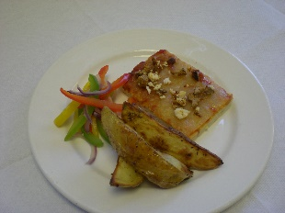
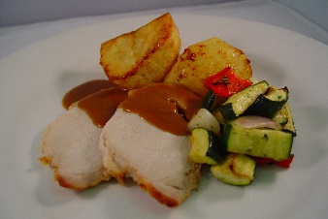
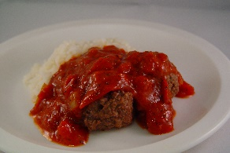

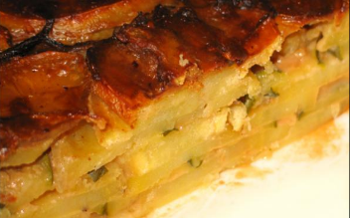
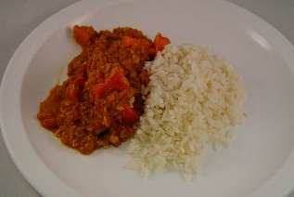
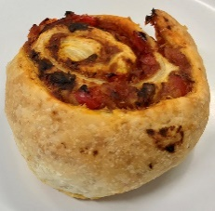
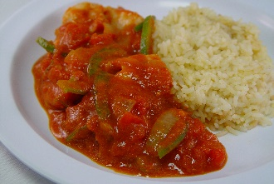
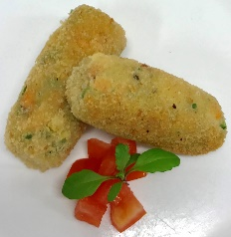

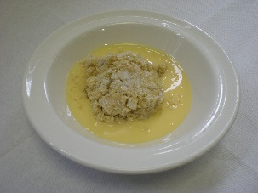



ALLERGY INFORMATION: If your child has an allergy or intolerance please ask a member of the catering team for information. If your child has a school lunch and has a food allergy or intolerance you will be asked to complete a form to ensure we have the necessary information to cater for your child.
Spring Menu 2018
 |  | Monday | Tuesday | Wednesday | Thursday | Friday
Week 1 | Main | Chicken Chow Mein | Wholemeal Chicken and Red Pepper Pizza with Baked Potato | Roast (as advertised) With Roast Potatoes and Gravy | Beef Meatballs in a Tomato Sauce with Rice | MSC Breaded Fish With Chipped Potatoes, Tomato Sauce
 | Vegetarian | Potato & Courgette Layer Bake | Lentil and Vegetable Curry with Rice | Cheese & Pepper Whirl with Roast Potatoes | BBQ Quorn with Rice | Glamorgan Sausage with Chipped Potatoes
 | Dessert | Fruit Yoghurt and Shortbread | Apple and Mixed Berry Crumble & Custard | Banana Sponge & Custard | Pineapple upside down Cake with Custard | Pear & Ginger Muffin
Available Daily
Freshly cooked jacket potatoes with a choice of fillings (where advertised)
Bread freshly baked on site daily
Daily salad selection
Fresh fruit and yoghurt

Slide 2

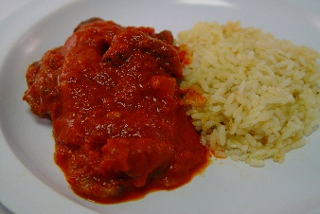
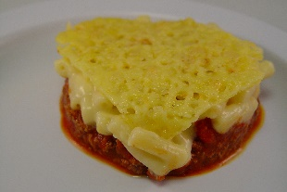
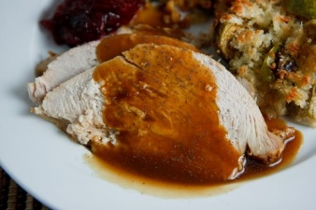
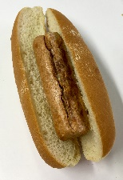
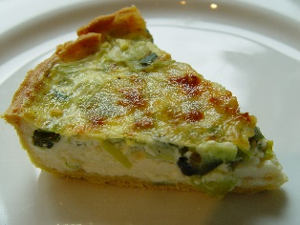
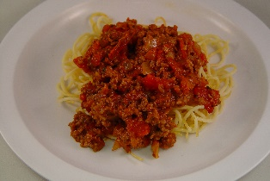
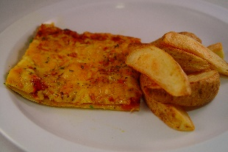
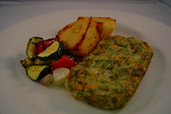
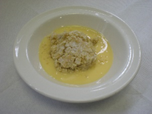
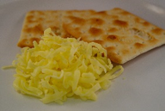

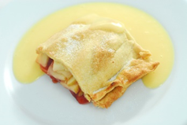

ALLERGY INFORMATION: If your child has an allergy or intolerance please ask a member of the catering team for information. If your child has a school lunch and has a food allergy or intolerance you will be asked to complete a form to ensure we have the necessary information to cater for your child.
Spring Menu 2018
 |  | Monday | Tuesday | Wednesday | Thursday | Friday
Week 2 | Main | Hot Dogs with Homemade Tomato Sauce and Homemade Jacket Wedges | Baked Greek Lasagne | Roast Turkey with Roast Potatoes & Gravy | Beef Goulash with Rice | MSC Battered Fish Chipped Potatoes, Tomato Sauce
 | Vegetarian | Quorn Hot Dog with Toamto Sauce | Wholemeal Spinach & Tomato Quiche with New Potatoes | Mixed Vegetable Loaf | Quorn Mince Pasta Bolognaise | Cheese and Tomato Pizza with Chipped Potatoes
 | Dessert | Pear Crumble and Custard | Apple, Cheese and Biscuits | Chocolate Cookie with Natural Yogurt | Apple & Berry Strudel with Custard | Chocolate and Orange Brownie
Available Daily
Freshly cooked jacket potatoes with a choice of fillings (where advertised)
Bread freshly baked on site daily
Daily salad selection
Fresh fruit and yoghurt

Slide 3
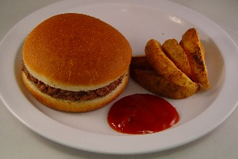
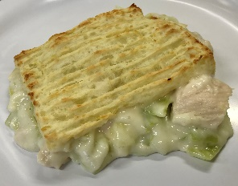
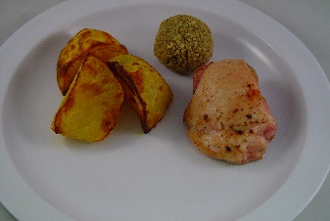
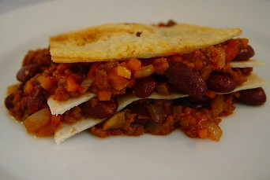

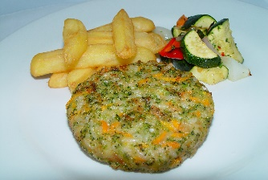
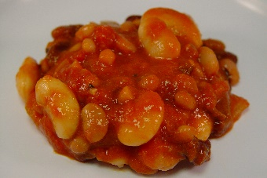
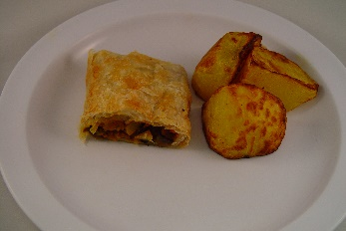
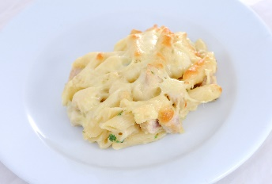
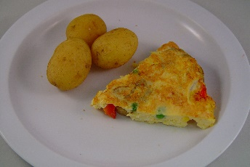

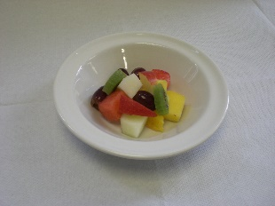

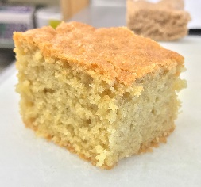
ALLERGY INFORMATION: If your child has an allergy or intolerance please ask a member of the catering team for information. If your child has a school lunch and has a food allergy or intolerance you will be asked to complete a form to ensure we have the necessary information to cater for your child.
Spring Menu 2018
 |  | Monday | Tuesday | Wednesday | Thursday | Friday
Week 3 | Main | Beef Burger in a Bun | Turkey & Vegetable Pie | Roast Chicken & Stuffing with Roast Potatoes and Gravy | Beef Tortilla Stack & Rice with Garlic Slice | MSC Salmon Fish Fingers with Chipped Potatoes, Tomato Sauce
 | Vegetarian | Vegetarian Burger in a Bun | Mixed Bean Cassoulet with Mash Potato | Vegetarian Wellington with Roast Potatoes | Macaroni Cheese | Cheese Tomato & Spinach Frittata with Chipped Potatoes
 | Dessert | Carrot & Sultana Cake with Custard | Tuti Fruity Tuesday | Wholemeal Peach Crumble & Custard | Jelly with a side of Mandarins | Lemon Surprise Cake
Available Daily
Freshly cooked jacket potatoes with a choice of fillings (where advertised)
Bread freshly baked on site daily
Daily salad selection
Fresh fruit and yoghurt

