Slide 1
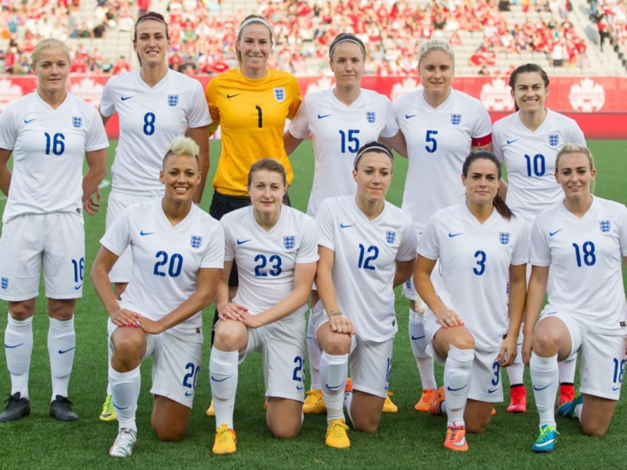
Girls - Rew Valley FC needs YOU!!!!
Rew Valley Youth FC are creating a girls under 12’s football team for the upcoming 2016/2017 season.
We are looking for girls aged between 9 and 11 who are interested in playing football, developing their skills and working with trained coaches in a safe and relaxed environment.
From those who attend training, we will be looking to sign a number of players to compete in matches played on Sunday mornings. We are hoping to enter the Southampton District Girls Football Lea
There will be no cost for the first couple of taster sessions so please come along and bring your friends.
(All you will need is a pair of shin pads, trainers, boots if you have them and plenty of drink)
For any more information please don't hesitate to contact
Conner Knight: 07740964767 or connerknight15@gmail.com
Venue: St Francis Primary, Ventnor (School fields, access behind the astro) 9.30-10.30am.
Dates:
Sunday 19th June
Saturday 25th June
Sunday 3rd July

