Slide 1
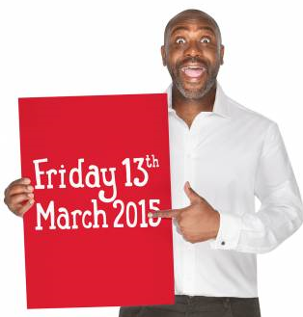
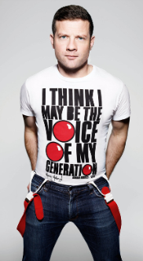
Don’t miss out on buying your Official Comic Relief T-shirt!!
**Quick! Get yours now…whilst stocks last!**
“Head on down to your nearest store!”
TK Maxx,
52 Pyle St,
Newport,
IOW
PO30 1XB

